Slide 1





DayCare
1
Team Number : 6
Hariharan Raj 002762090
Goodwin Hector 002708280
Vedantini Dilip Gaikwad 002998254
Vyshnavi Devi Doppalapudi 002772942
Chaman Betrabet 002784662
Abhishek Singh 002703946
Sandhya Morla 002727499

Slide 2


2
Abstract
Tech-Stack
Features
UML Diagram
Contributions
Output
Future enhancements
Table of Contents

Slide 3

Abstract
This application is that of a Day Care System which is in par with a real-world application, that consists of various Organizations and Roles. The project is implemented using Swing GUI widget toolkit.
It is a School Management(Day Care) System with features that provides access to:- (i) Adding Students and Teachers with their details, easily updating, deleting records & viewing all records. (ii) Adding Vaccine information for each student. (iii) Provides a feature for the teachers to view students who are yet to take the vaccine. (iv) Giving feedback of Teachers by Students using the Annual Review feature. (v) Provides filtering through a combo box that displays different age groups in a classroom.
3

Slide 4



Tech Stack
Java
Swing For GUI
Java AWT
4
MVC Architecture
CSV for DB

Slide 5


Features
5
Login Page for Admin
Performed CRUD operations on student management Performing annual reviews for teacher management Immunization records can be updated regularly Students are assigned to teachers based on their age Immunization record keeping made easier.

Slide 6
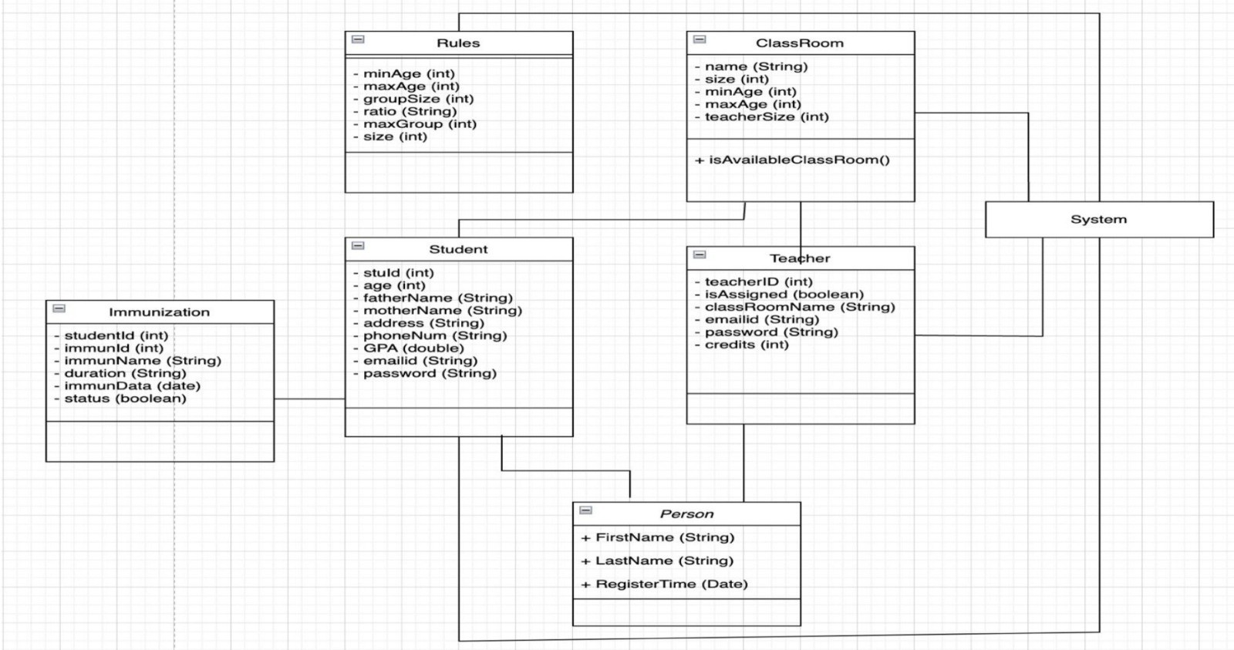
Uml Diagram
6

Slide 7
7 Contributions
Hariharan Raj
Goodwin Hector
Vedantini Dilip Gaikwad
Teacher Registration
Login Page and Authorization
Design Patterns and Immunization
Chaman Betrabet
Abhishek Singh
Sandhya Morla
Student Registration and view update
Teacher view update and UI Design
UML Diagram Designing, Class view
and update
Vyshnavi Devi Doppalapudi
Rating Management and Presentation

Slide 8
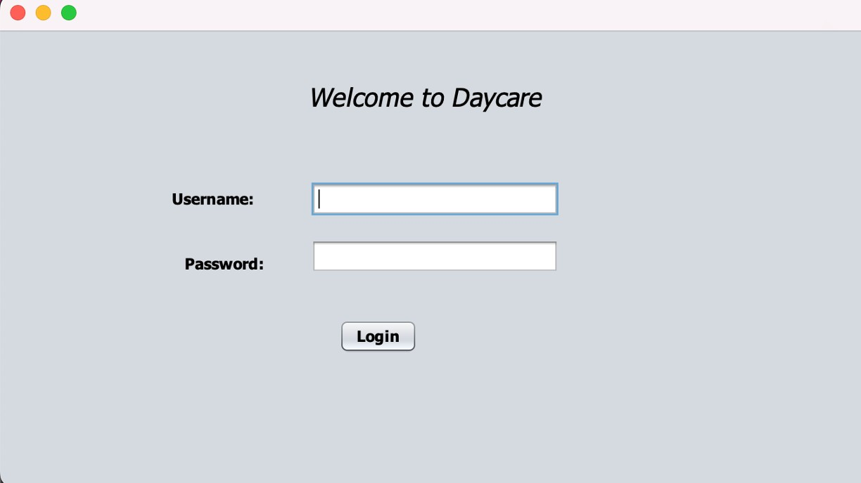

Output
Login Page
8

Slide 9
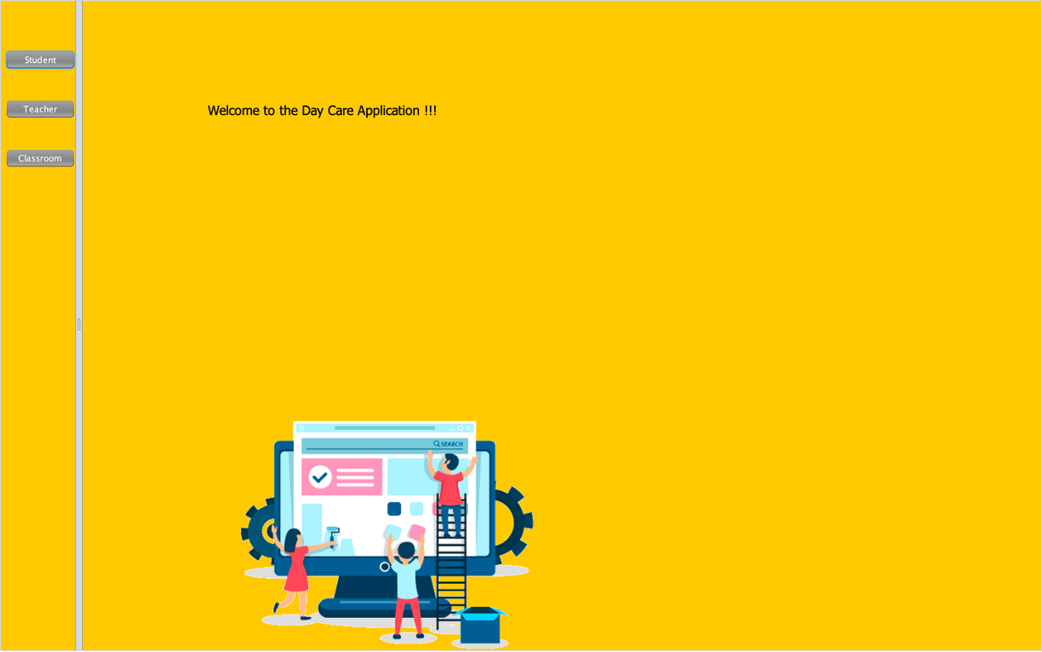
Home Page
9

Slide 10
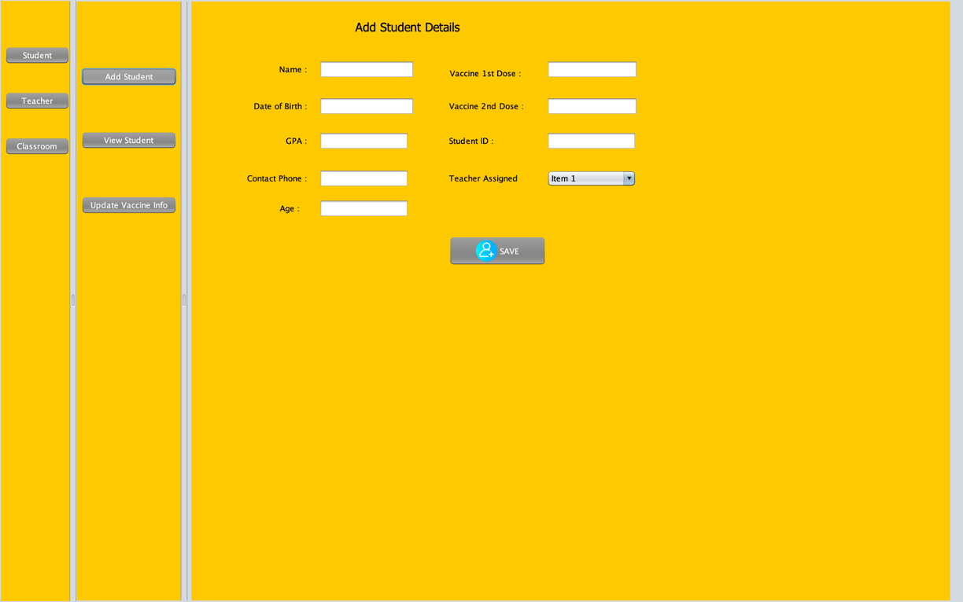
Students - Add Student
10

Slide 11
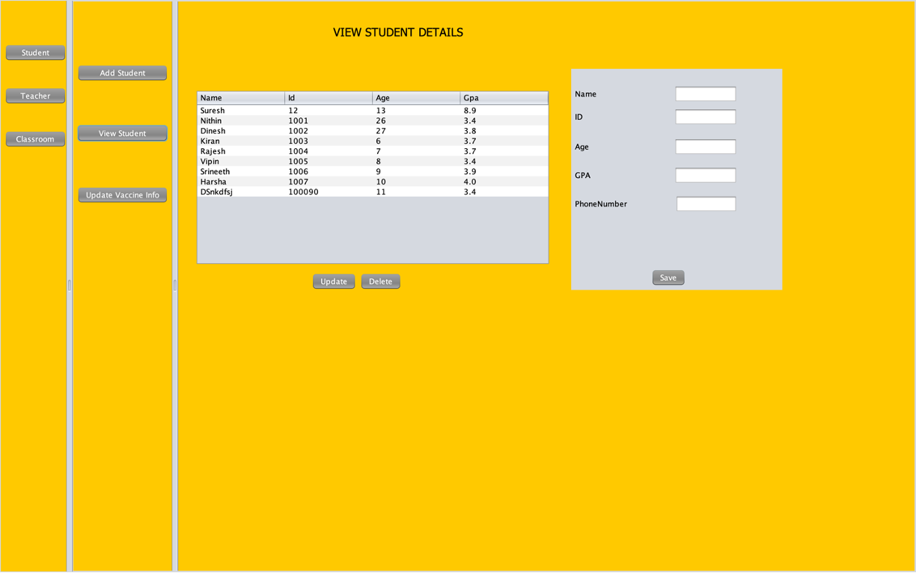
Students - View Student
11

Slide 12
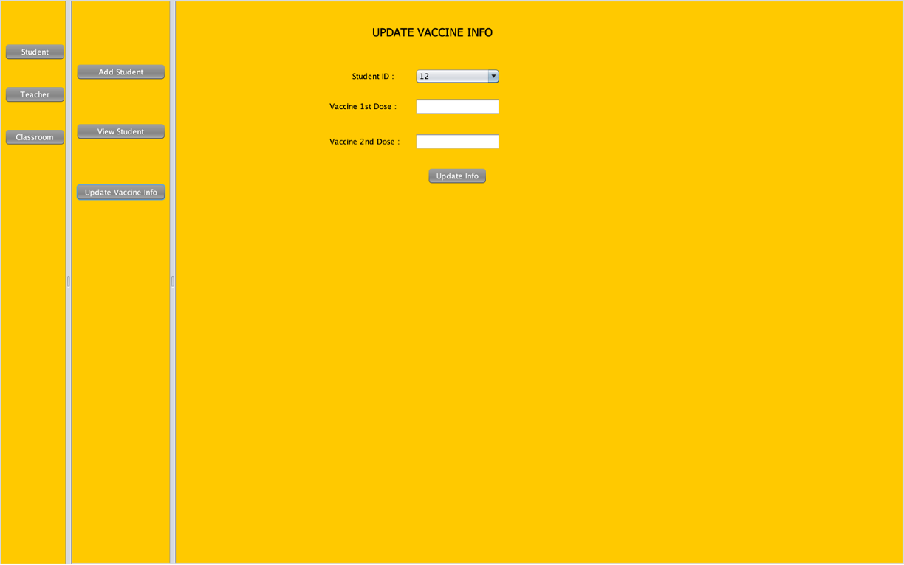
Students - Update Vaccine Info
12

Slide 13
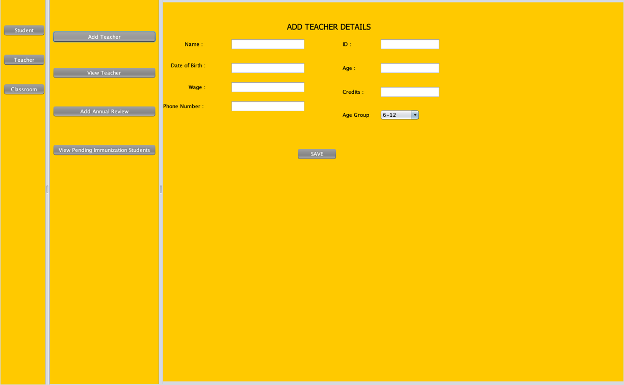
Teachers - Add Teacher
13

Slide 14
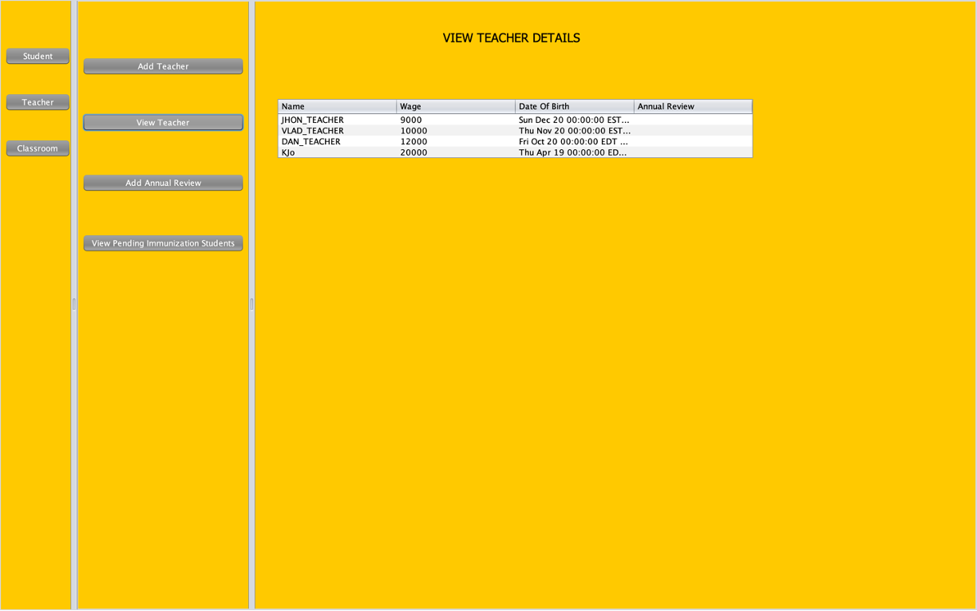
Teachers - View Teacher
14

Slide 15
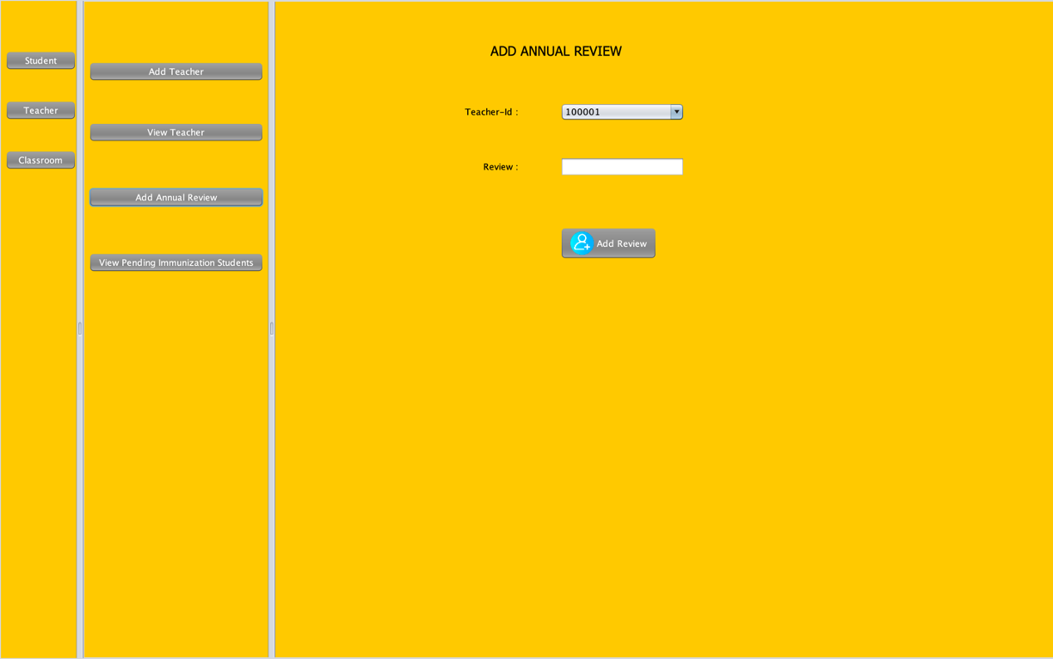
Teachers - Add Annual Review
15

Slide 16
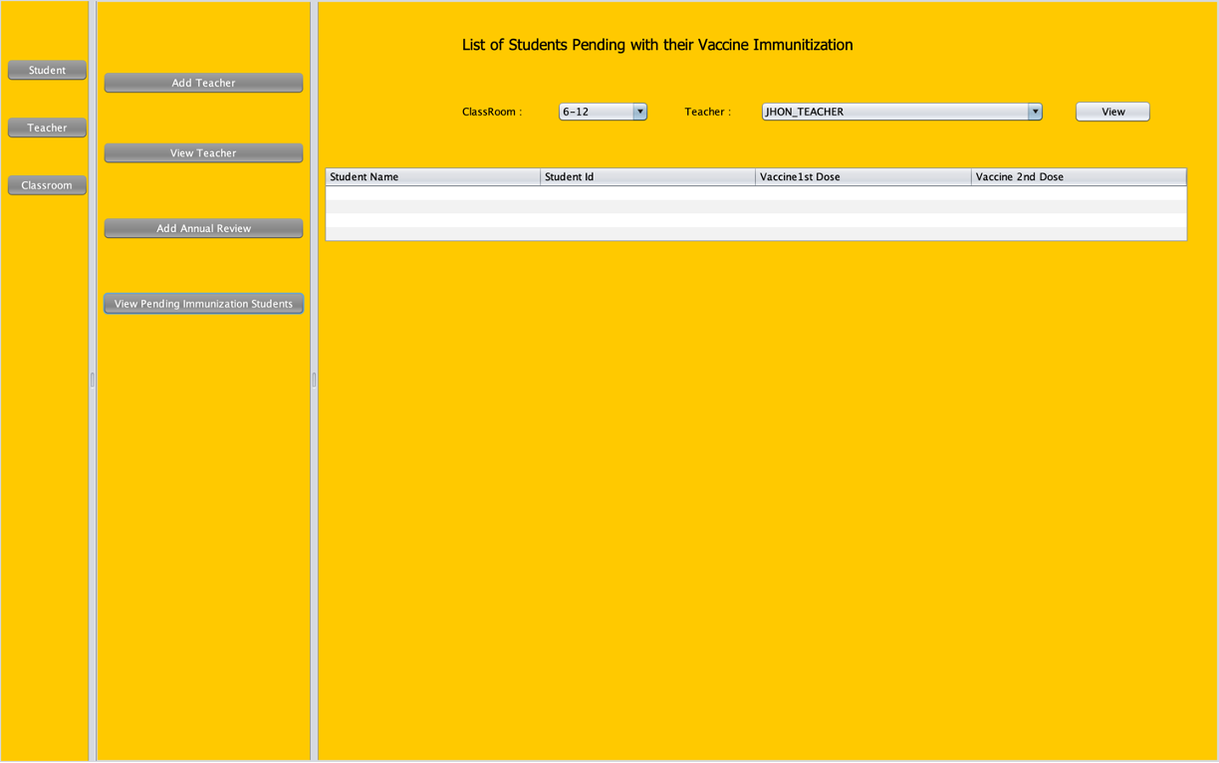
Teachers - Pending Immunisation
16

Slide 17
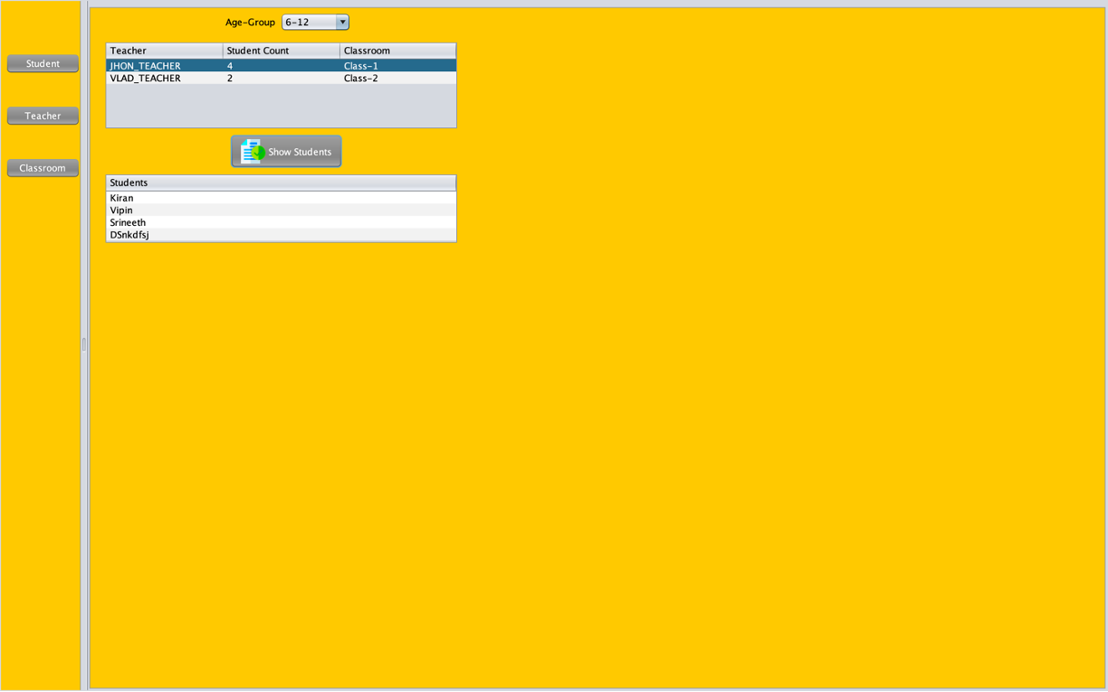
Classroom
17

Slide 18
Future Enhancements
Creation of course enrollment page for students to register to courses. Create individual sign-up pages for creating accounts.
Triggering email notification for every user creation and updates to their accounts Make use of Spring boot instead of swing for more user friendly application Storing data can be made easy with cloud db instead of CSV files
18

